Slide 1

Step by Step Instructions

Slide 2
STEP - I - Arduino IDE Download & Installation

Slide 3
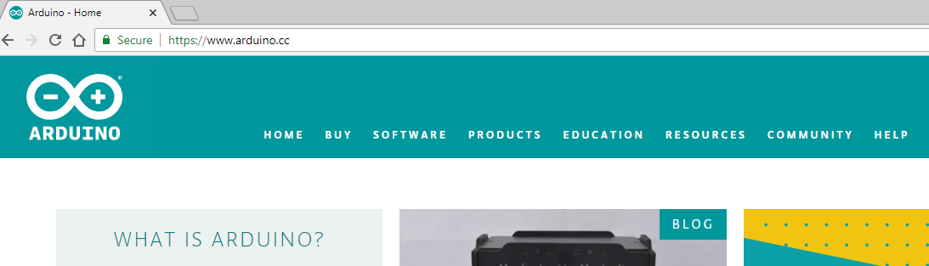
Go to Arduino.CC in your favourite Browser

Slide 4

Go to Software section and then Downloads

Slide 5
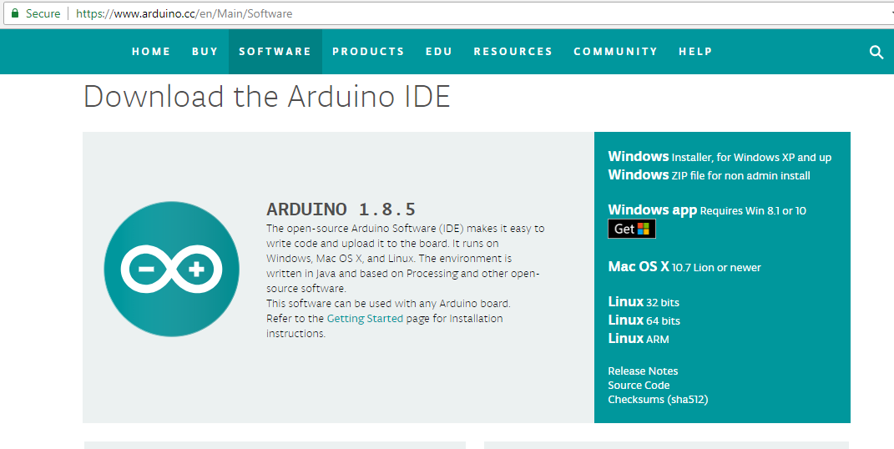
Scroll Down to Download the Arduino IDE

Slide 6
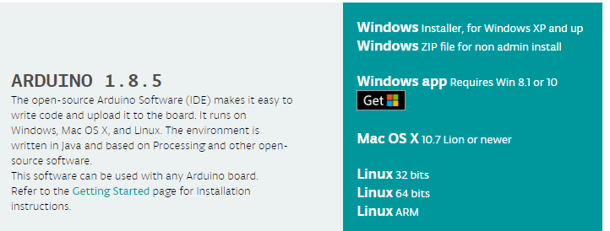
Choose the appropriate Version for your Operating System - Win/Mac/Linux

Slide 7

Click on Just Download unless you are feeling too Generous :)

Slide 8
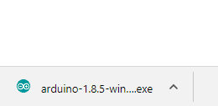
Open Downloaded File and Click Yes to Permission

Slide 9
Follow On Screen Steps to Finish Installation

Slide 10
STEP - II - ESP8266 Boards Installation

Slide 11
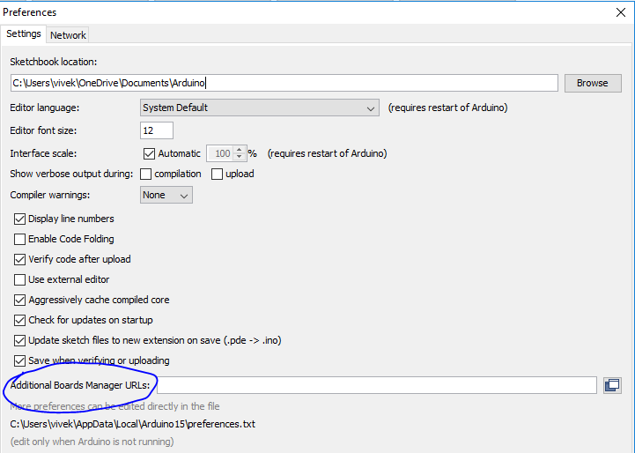
Go to
File -> Preferences and then in
Bottom half of Preferences,
Find
Additional Board Managers URLSs section as shown

Slide 12
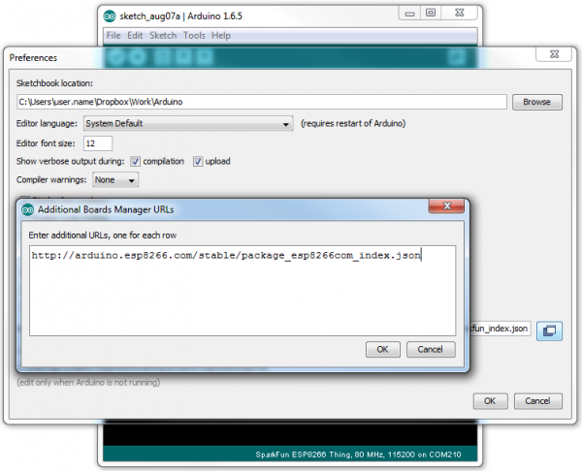
Add
http://arduino.esp8266.com/stable/package_esp8266com_index.json

Slide 13
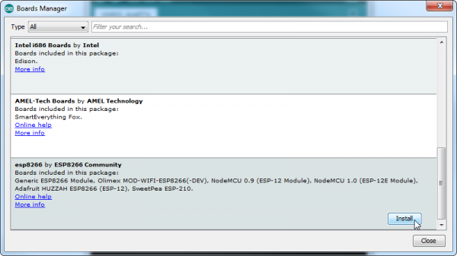
Go to Tools -> Boards -> Board Manager. Search For ESP8266 and click Install

Slide 14
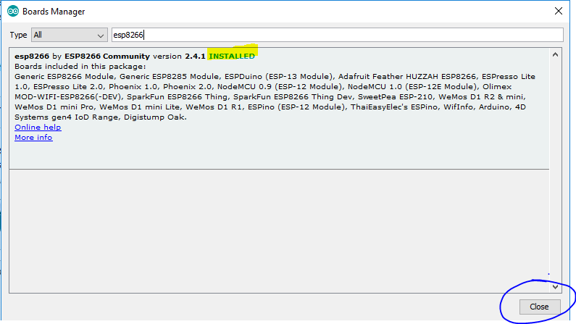
Once you get INSTALLED against it , Click Close and this step is done

Slide 15
STEP - III - Installation of Libraries

Slide 16
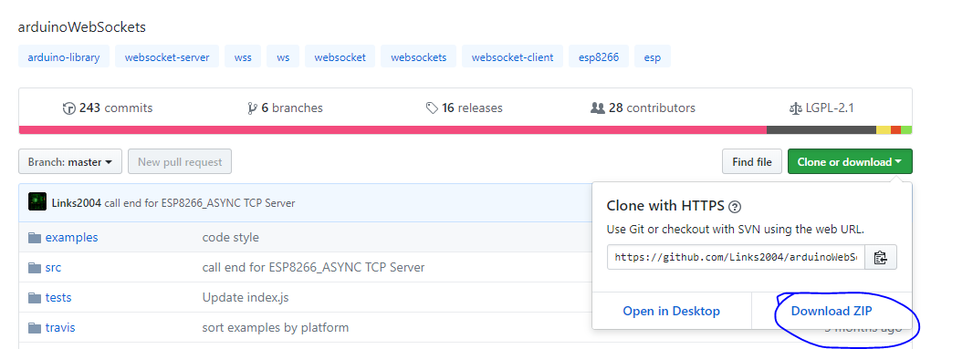
Go To
https://github.com/Links2004/arduinoWebSockets
Click on Clone or download and then Download ZIP

Slide 17
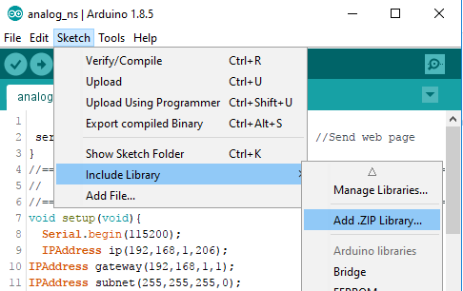
In Arduino IDE:
Sketch -> Include Library -> Add .zip Library

Slide 18
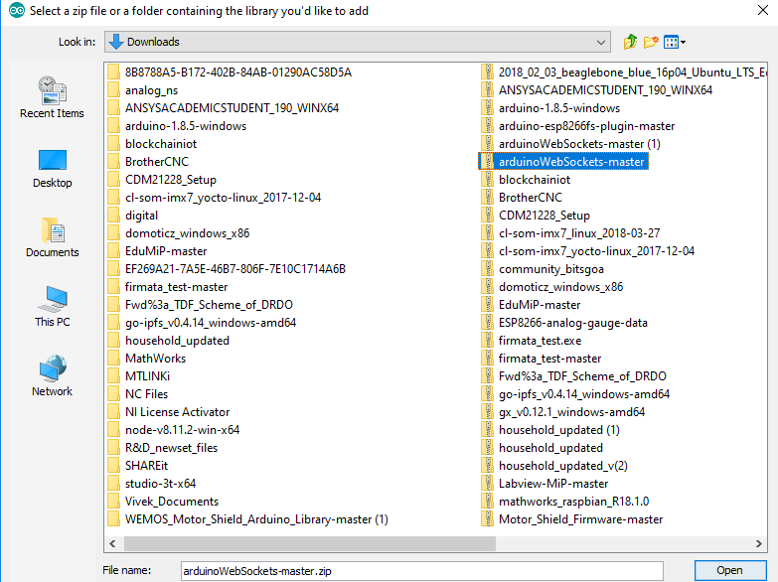
Point to the Downloaded Library - arduinowebSocketsmaster.zip
It’ll be in your default Download Location

Slide 19
STEP - IV - Install Board Driver

Slide 20
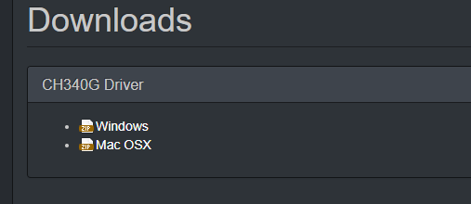
Go to https://wiki.wemos.cc/downloads and select appropriate Driver for your OS

Slide 21
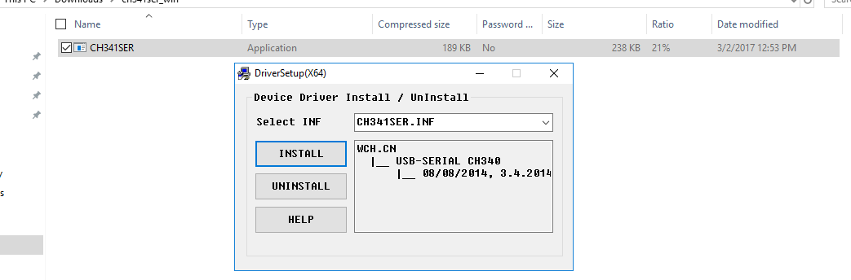
Open the CH341SER.exe in the downloaded file and Click Install

Slide 22
STEP - V - Uploading the Code

Slide 23
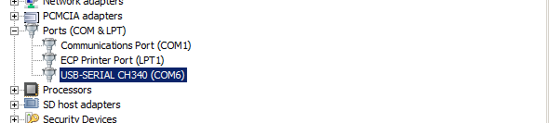
Plug in the Board through USB
In Devices Manager, you will find it as USB SERIAL CH340 (COMXX), Make a note of this COM Port No.

Slide 24
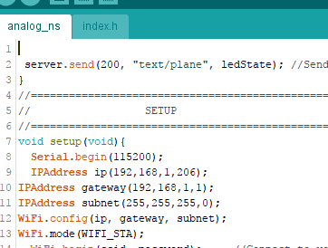
Open Analog or Digital code as desired.
Note: For Analog, make sure index.h file is open too.

Slide 25
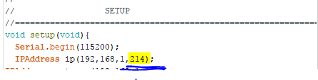
In Setup Section of Code : Change arguments in IPAddress ip to (192 168 1 21X) eg. (192 168 1 214)

Slide 26
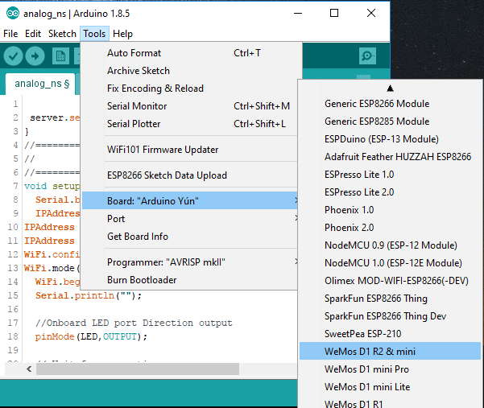
In
Tools ->Board
Under ESP8266
Select
WeMos D1 R2 & mini

Slide 27
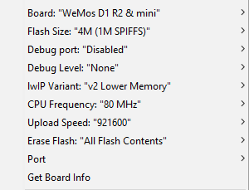
Select the Following settings for the board:
Erase Flash : “All Flash Contents”

Slide 28
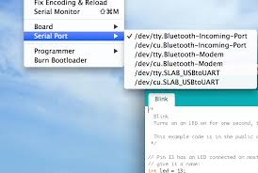
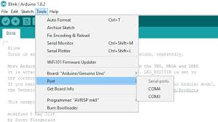
In Port Setting : Choose the Port as you obtained from Device Manager in the previous steps
Win
MAC/Linux

Slide 29
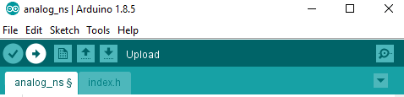
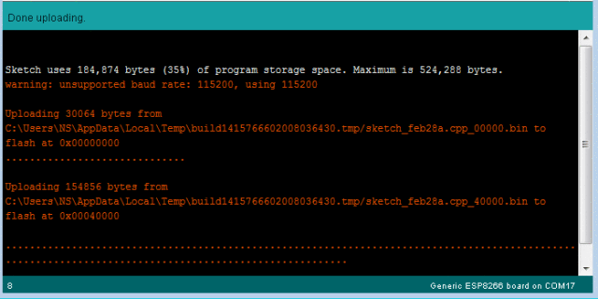
Click on Upload(->) to Flash Sketch and wait for the Flash status to reach 100% and Done Uploading Message to Pop Up

Slide 30
You are all Set!
Connect to IAOE@ASEE
Pass : OnlineEngineering
Open your browser and Enter in URL : 192.168.1.21X

